Slide 1
BCH Academy for Teaching and Educational Innovations and Scholarship Building Trust Across Learner Professions Ellen Goodman, MSW Jennifer Kesselheim MD, MEd

Slide 2
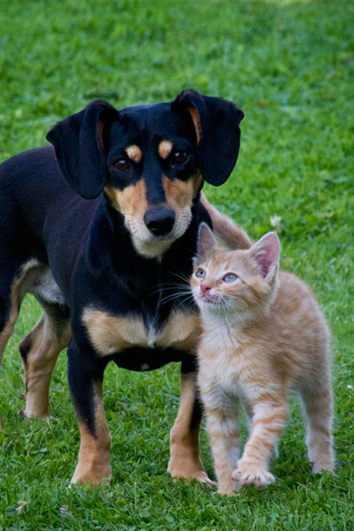
Getting to Know You
Find someone you don’t already know
Introduce yourself and:
describe how you chose your health profession
name one thing that is important to know about you, in your role as a healthcare professional

Slide 3
Trust in Interprofessional Teams
Universally relied on but rarely discussed
Implicit in the function of healthcare teams
Inhibits errors, biases, stereotypes
Begins with self awareness & communication
Notes:
After 2nd bullet: We have to trust and rely on each other BECAUSE we don’t hold the same areas of knowledge, skill and expertise
Bullet 4: know your own biases and knowledge gaps about your colleague's professional background

Slide 4
Elements of Trust
Domains of trust:
Profession
Knowledge and skills
Work ethic
Character
Trust based on:
Competence and performance
Title, degree, status, positional authority
Notes:
Here’s where I’m coming from and why- my orientation
*****Knowledge and skills: Recognize own limits, when to ask for help
Work ethic-Conscientious, reliable, can count on me

Slide 5
What Facilitates Trust in Teams?
Understand, respect and value profession and individual
Clear roles and responsibilities
Encourage participation of others
Honesty, openness and curiosity
Leader and a listener
Shared goals and values
Notes:
Here’s where I’m coming from and why
Value of social interactions: across differences
Ruth Bader Ginsberg and Anthony Scalia
Members of congress across parties used to socialize and dine together; in a time when we weren’t so fractured across party lines

Slide 6
Psychological Safety
Beliefs
Respect for each other’s abilities
Interested in each other as people
Not rejected for stating what you think
Able to make mistakes
Members have positive intentions
(Edmundson, 1999)
Notes:
Shared belief that the team is safe for interpersonal risk taking. Concept developed in 1999 by Amy Edmundson, HBS professor. She was studying teams in hospitals and came to the realization that better teams reported more mistakes, not because they made more mistakes, but because they were actually more willing and able to talk abut their mistakes. In her subsequent work she has observed how a trusting work place positively impacts team performance.
***A belief that one will not be punished or humiliated for speaking up with ideas, questions, concerns, or mistakes
-There’s mutual respect and trust among team members
Trust intentions, knowledge and skills
Trust contributes to PS and PS contributes to trust- they’re interdependent-

Slide 7
Psychological Safety
Behaviors
Seeking and giving feedback
Asking for and giving help
Making improvements or changes
Trying new things
Engaging in productive disagreements
Notes:
Shared belief that the team is safe for interpersonal risk taking
-Members are not rejected or punished for speaking up
-There’s mutual respect and trust among team members
Trust intentions, knowledge and skills
Trust is critical for PS and PS creates trust- they’re interdependent- trust contributes to safety and safety influences trust

Slide 8
Fostering Psychological Safety
Model and lead by example
Encourage active listening
Develop an open mindset
Share failures and mistakes
Solicit input
Give direct, honest feedback
Engage in constructive conflict
Forgive others’ mistakes (and your own)
Notes:
Ongoing journey
Build new teams or work with transient, ad hoc teams
W/o trust we withhold our ideas, concerns, and questions

