Slide 1
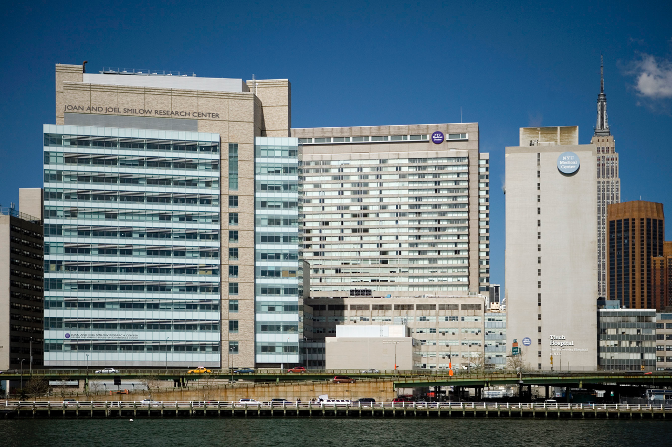
Practice Makes Perfect:
Towards Making CME More Systematic
The Master Adaptive Learner Framework
Martin Pusic MD PhD
Institute for Innovations in Medical Education
Division of Learning Analytics
NYU School of Medicine

Slide 2

Outline
The Ambition
Definition of the Master Adaptive Learner Framework
Adaptive Expertise
Component learning processes
Disclosure: Funded investigator with the American Medical Association “Accelerating Change in Education” initiative.

Slide 3
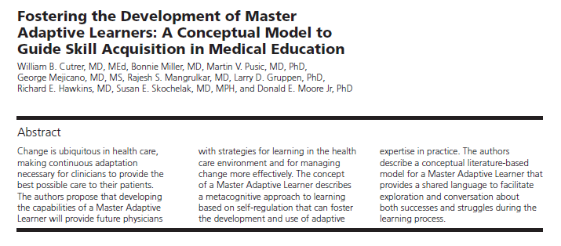
Academic Medicine, 92(1), pp.70-75.

Slide 4
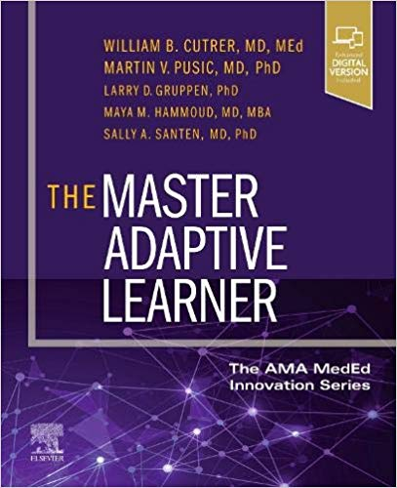

Slide 5
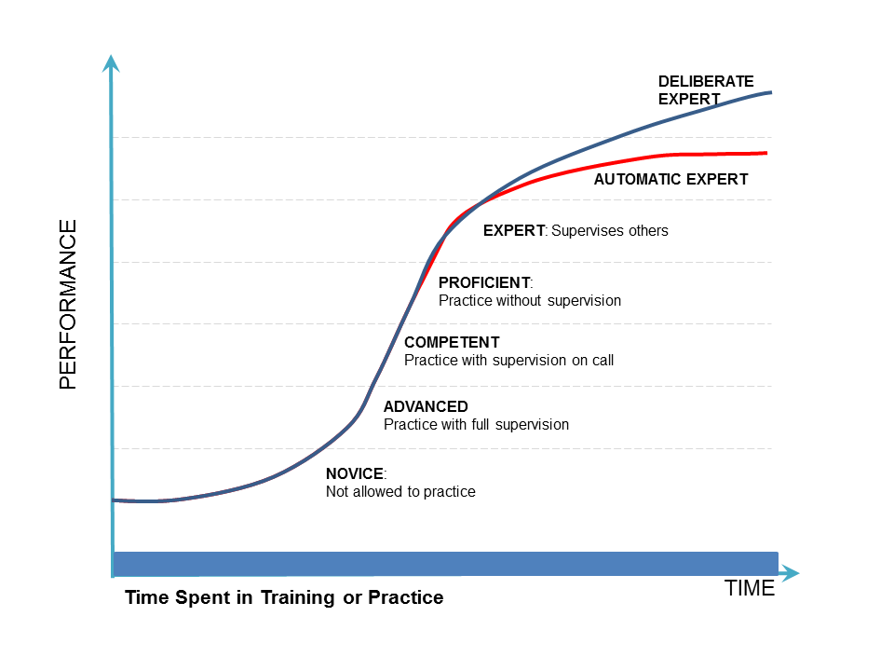
Dreyfus and Dreyfus Model
Lifelong learning
  Learning to survive
  Learning to thrive
ADAPTIVE
EXPERT

Slide 6
Dreyfus and Dreyfus Model
Lifelong learning
  Learning to survive
  Learning to thrive
ADAPTIVE
EXPERT

Slide 7
Dreyfus and Dreyfus Model
Lifelong learning
  Learning to survive
  Learning to thrive
ADAPTIVE
EXPERT

Slide 8
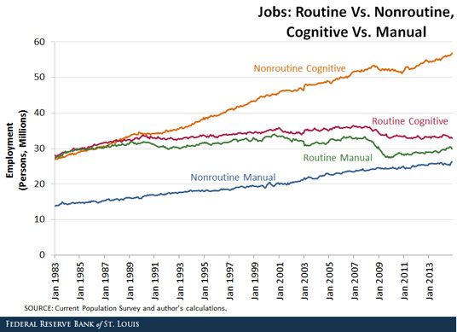

Slide 9
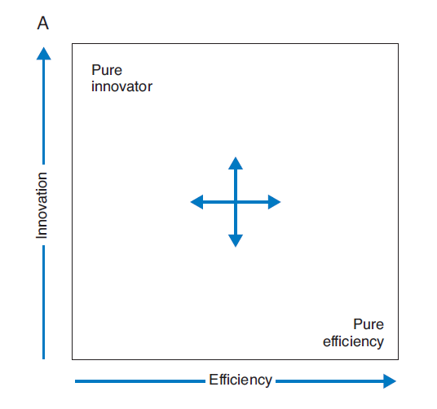
Adaptive Expertise

Slide 10
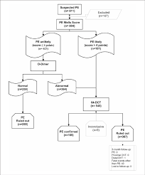

Slide 11
Adaptive Expertise

Slide 12
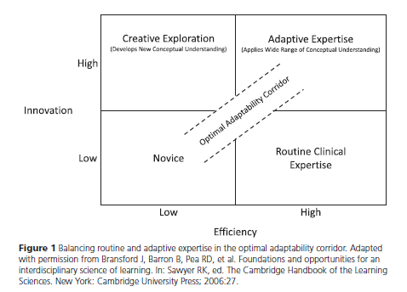

Slide 13
Dreyfus and Dreyfus Model
Lifelong learning
  Learning to survive
  Learning to thrive
ADAPTIVE
EXPERT

Slide 14
Dreyfus and Dreyfus Model
Lifelong learning
  Learning to survive
  Learning to thrive
ADAPTIVE
EXPERT

Slide 15
Master Adaptive Learning compared with Linear Learning
Learning begets Learning
Initial Investment

Slide 16
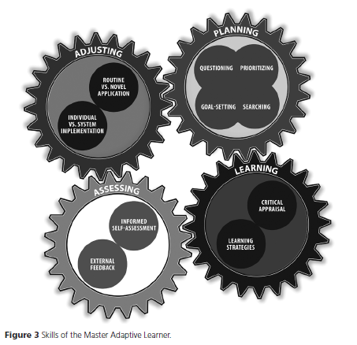
Master Adaptive Learner

Slide 17
Planning
The Planning phase incorporates three stages:
Identifying a gap
Prioritizing opportunities
Finding and appraising resources

Slide 18
Master Adaptive Learner

Slide 19
Learning
How do I learn?
The Learning phase is a period of intense focus in which the student wrestles with internalizing her new understandings that address her identified gap in knowledge, skill, or attitude.
Critical thinking
Evidence-based Learning
Science of Learning

Slide 20
Master Adaptive Learner

Slide 21
Assessing
Did the learning work?
She begins to use the new knowledge, skills, or attitudes to address the initial challenge and, in doing so, begins to form an opinion about its effectiveness.
Accept?
Reject?

Slide 22
Master Adaptive Learner

Slide 23
Adjusting
The implications of applying her new
learning in the clinical workspace are
considerable.
The learner must consider
whether the change needed is:
> Individual or system level
> Routine or Innovative

Slide 24

Process c/w Person
 | Process | Person
PLANNING | Generate questions | .Questioning attitude
LEARNING | Critically appraise | .Knows how to learn .Habit of learning
ASSESSING | Informed self assessment | .Feedback seeking behaviour .Metacognition
ADJUSTING | Incorporates into system | .Microsystem aware .Ready to innovate
Overall | .Fixed conception .Property of system | .Growth conception .Habits of mind

Slide 25
Master Adaptive Learner

Slide 26
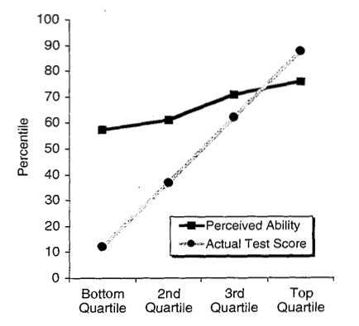
Planning

Slide 27
Planning

Slide 28
Master Adaptive Learner

Slide 29
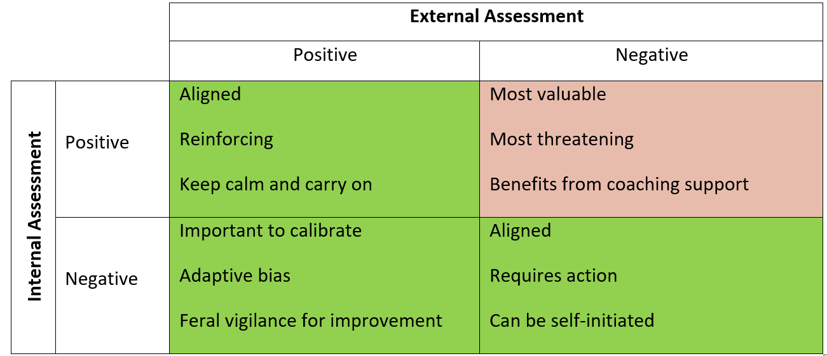
Assessing

Slide 30
Assessing

Slide 31
Assessing

Slide 32
Assessing

Slide 33
Master Adaptive Learner

Slide 34
Adaptive Expertise

Slide 35
Master Adaptive Learner

Slide 36
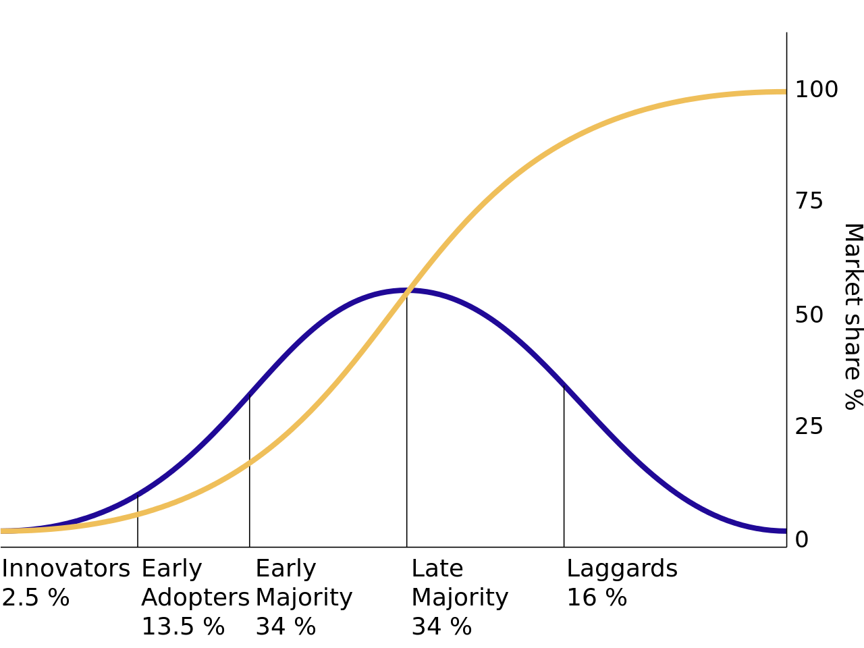
Rogers Innovation Curve

Slide 37
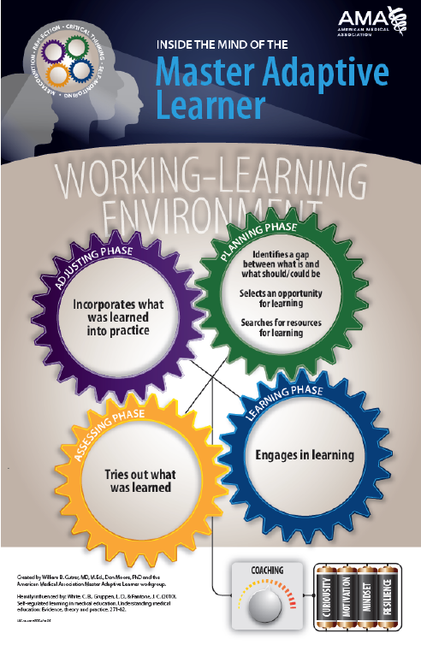

Slide 38
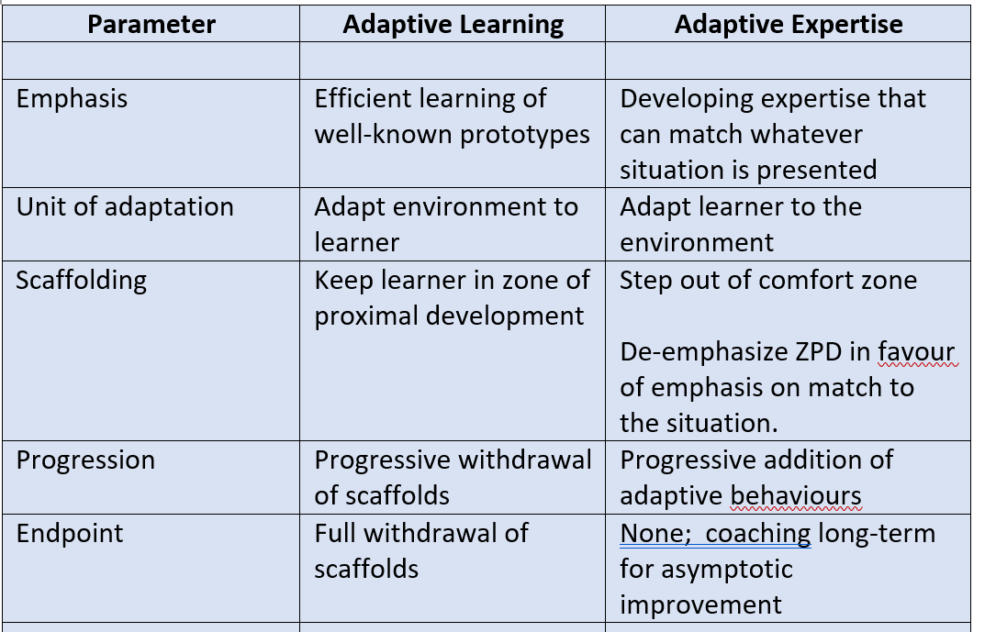
Traditional Learning
Adaptive Expertise

Slide 39
Summary
Mastery of the theories and methods of learning
Discerning right level of innovation
Learning part of core identity of a clinician
MASTER
ADAPTIVE
LEARNER

Slide 40
Summary
Mastery of the theories and methods of learning
Discerning right level of innovation vs. routine
Learning part of core identity of a clinician
MASTER
ADAPTIVE
LEARNER

Slide 41
Summary
Mastery of the theories and methods of learning
Discerning right level of innovation vs. routine
Learning part of core identity of a clinician
MASTER
ADAPTIVE
LEARNER

Slide 42
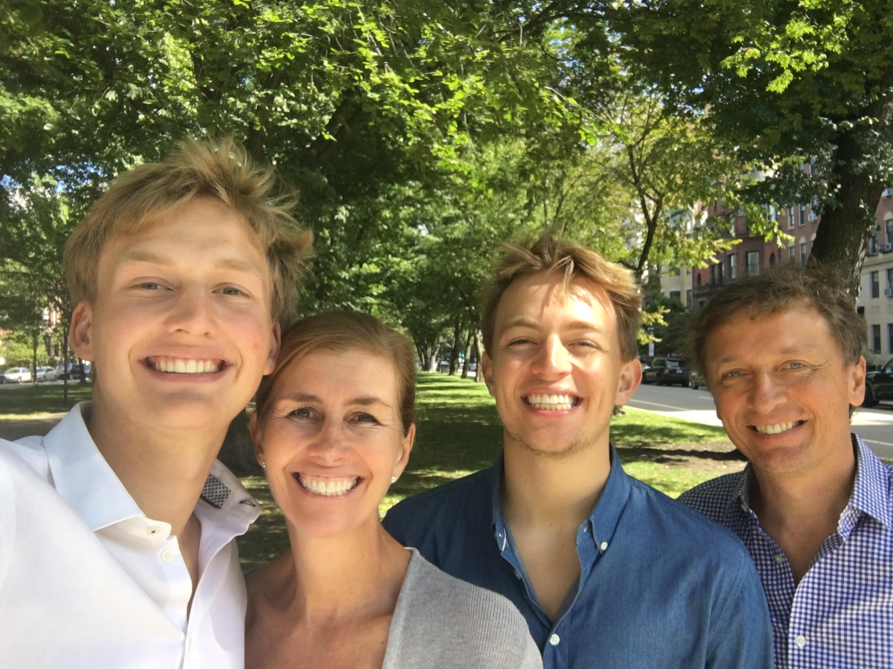
Discussion!

Slide 43
Remaining slides are only for discussion and will be used only if germaine to a question.

Slide 44
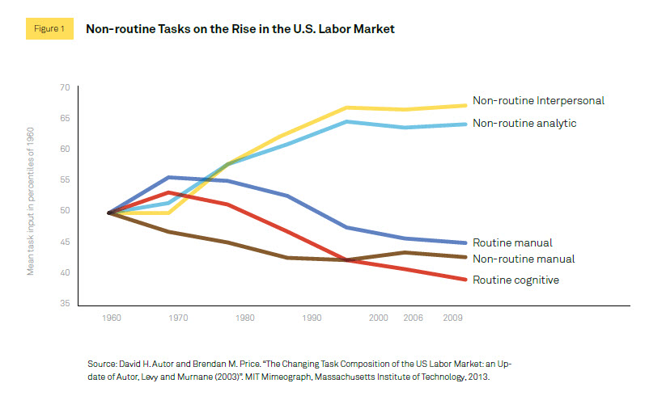

Slide 45
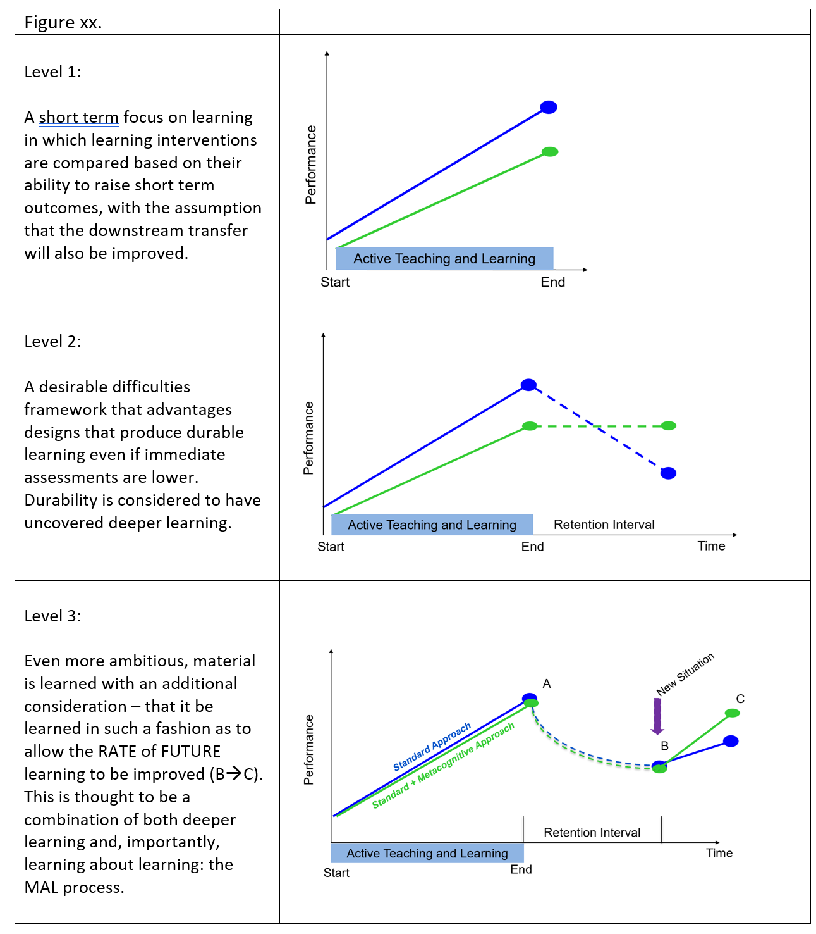

Slide 46
Dreyfus and Dreyfus Model
Lifelong learning
  Learning to survive
  Learning to thrive

Slide 48
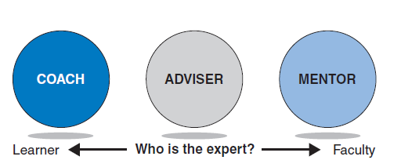
Coaching

Slide 49
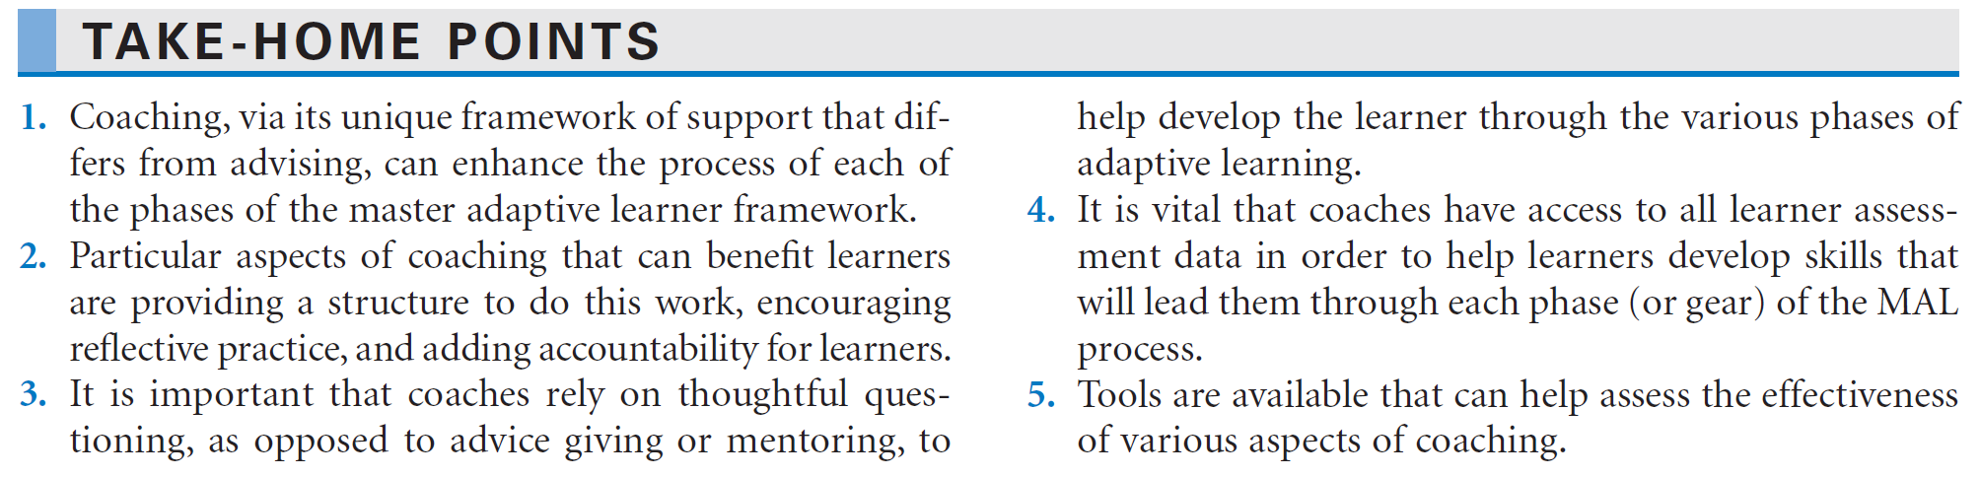
Coaching

Slide 50
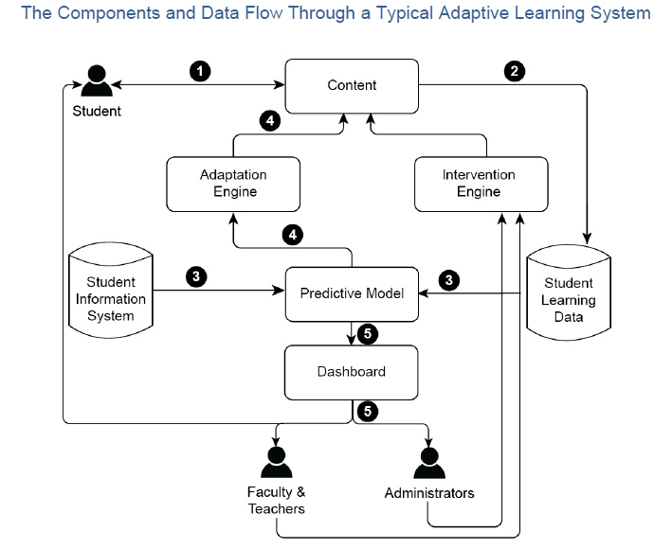

Slide 51
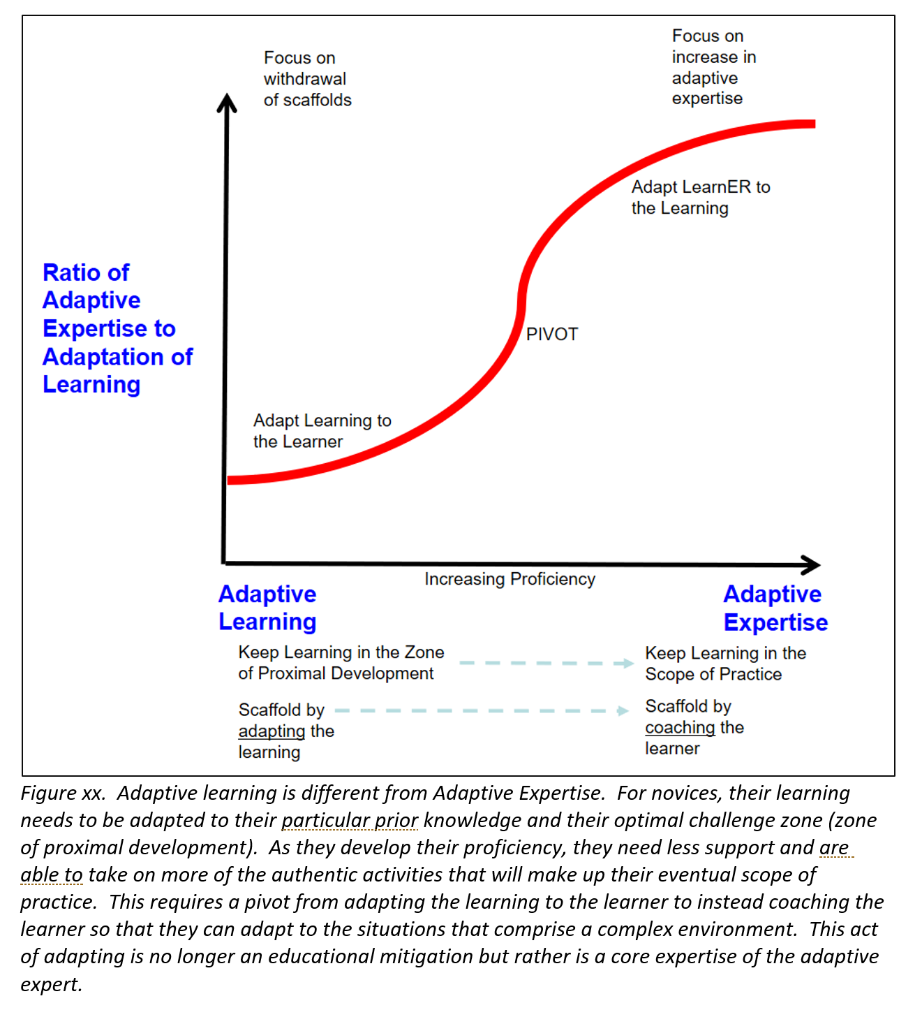

Slide 52
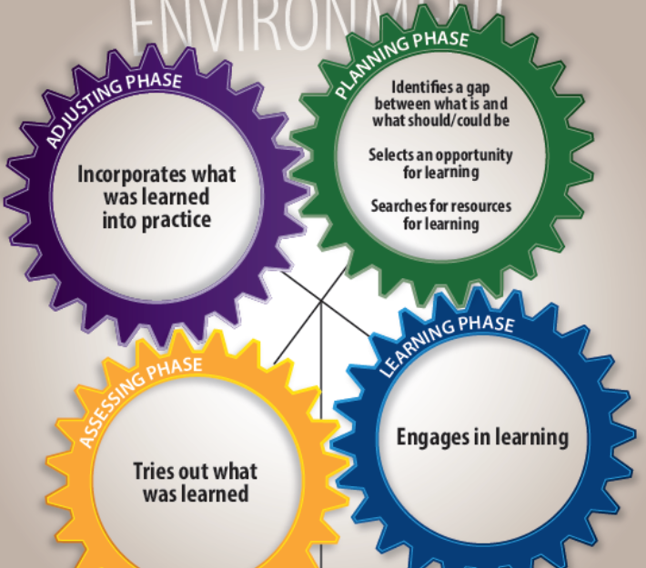

Slide 53
Summary
MAL is a process
MAL is a shared language
MAL are the traits of a learner
MAL is a way of being
…. All in service of being an Adaptive Expert

Slide 54
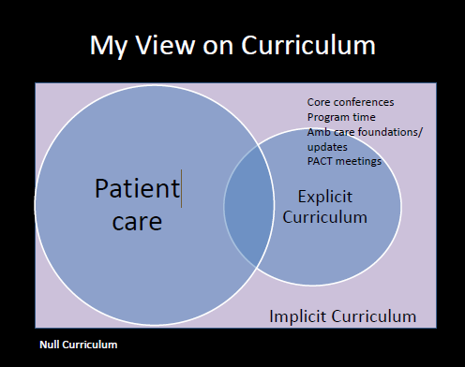

Slide 55
Adaptation/
Innovation

Slide 56
Interns
Senior
Fellows

Slide 57
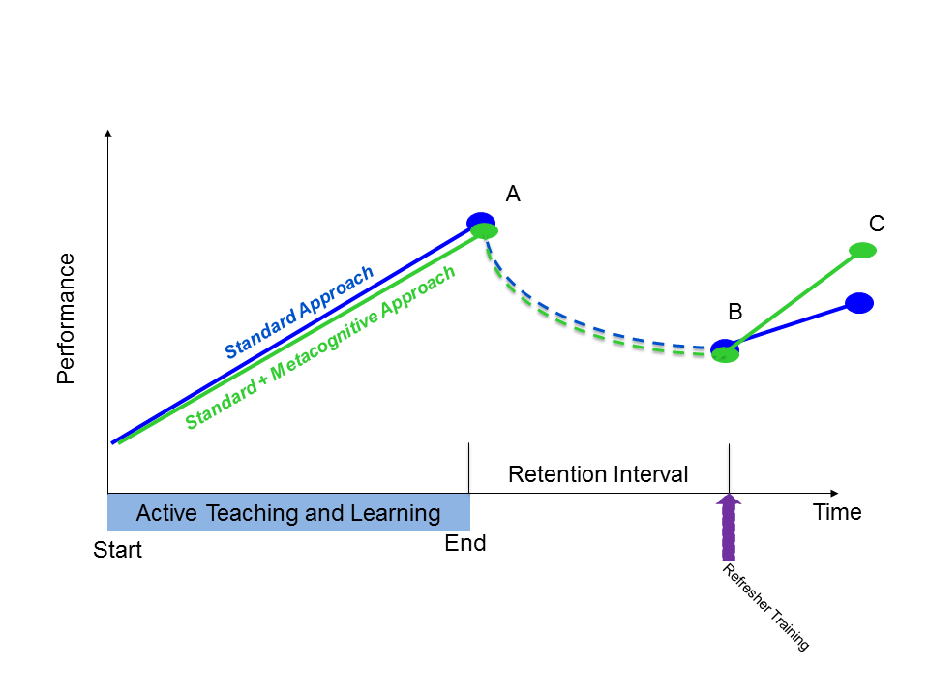
Master Adaptive Learner
Instructional
  How do we engender learning during medical school or residency that INCREASES future learning?
Internal medicine example
Developmental aspects

Slide 58
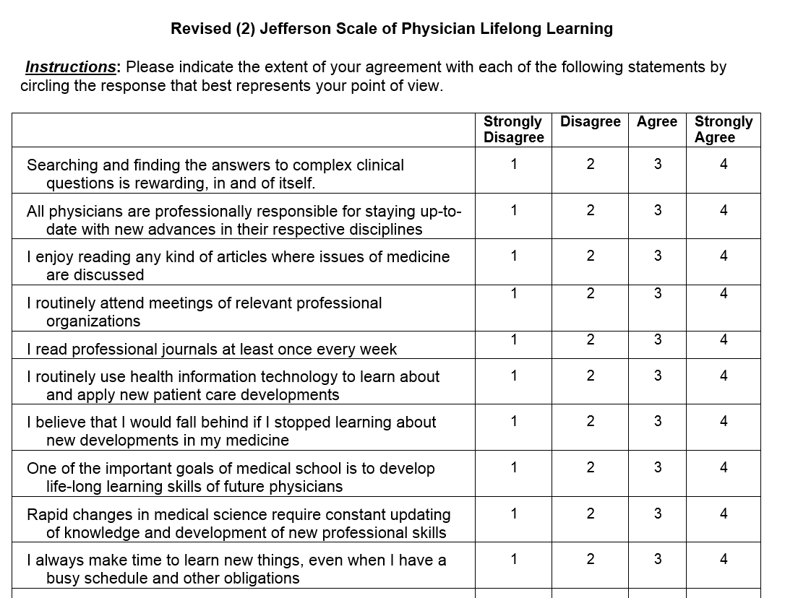
Hojat – Jefferson Life-Long Learning

Slide 59
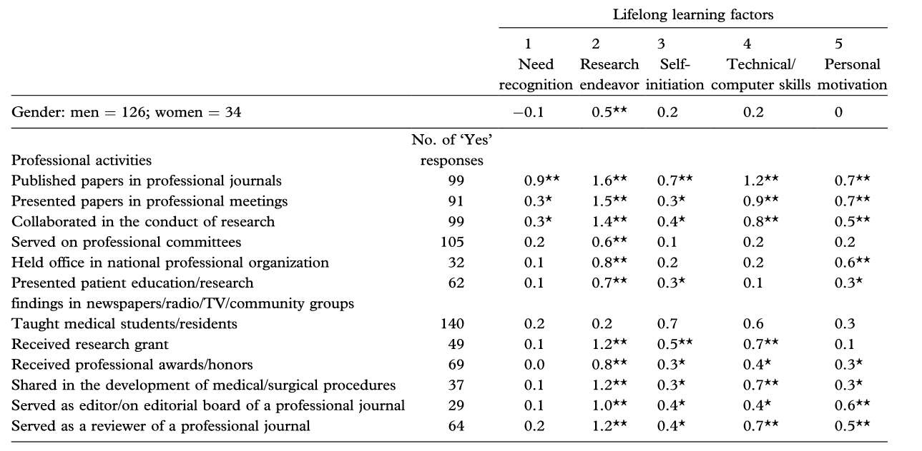

Slide 60
Master Adaptive Learner
Accelerating Change in Education
AMA Consortium
Vanderbilt University

Slide 61
IIME – Division of Learning Analytics
Mission: Develop and integrate novel ways of collecting, analyzing and presenting education data to further medical education at NYU.
Grant funding and Projects:
  Virtual patient panels (AMA)
  Master Adaptive Learner (AMA)
  Health Systems Science (AMA)
  Visual diagnosis of ECGs (DOD, RCPSC)
  Visual diagnosis of Radiographs (RCPSC, MED-U)
Personnel:
  Research coordinator, programmer, data scientist, collaborators

Slide 62
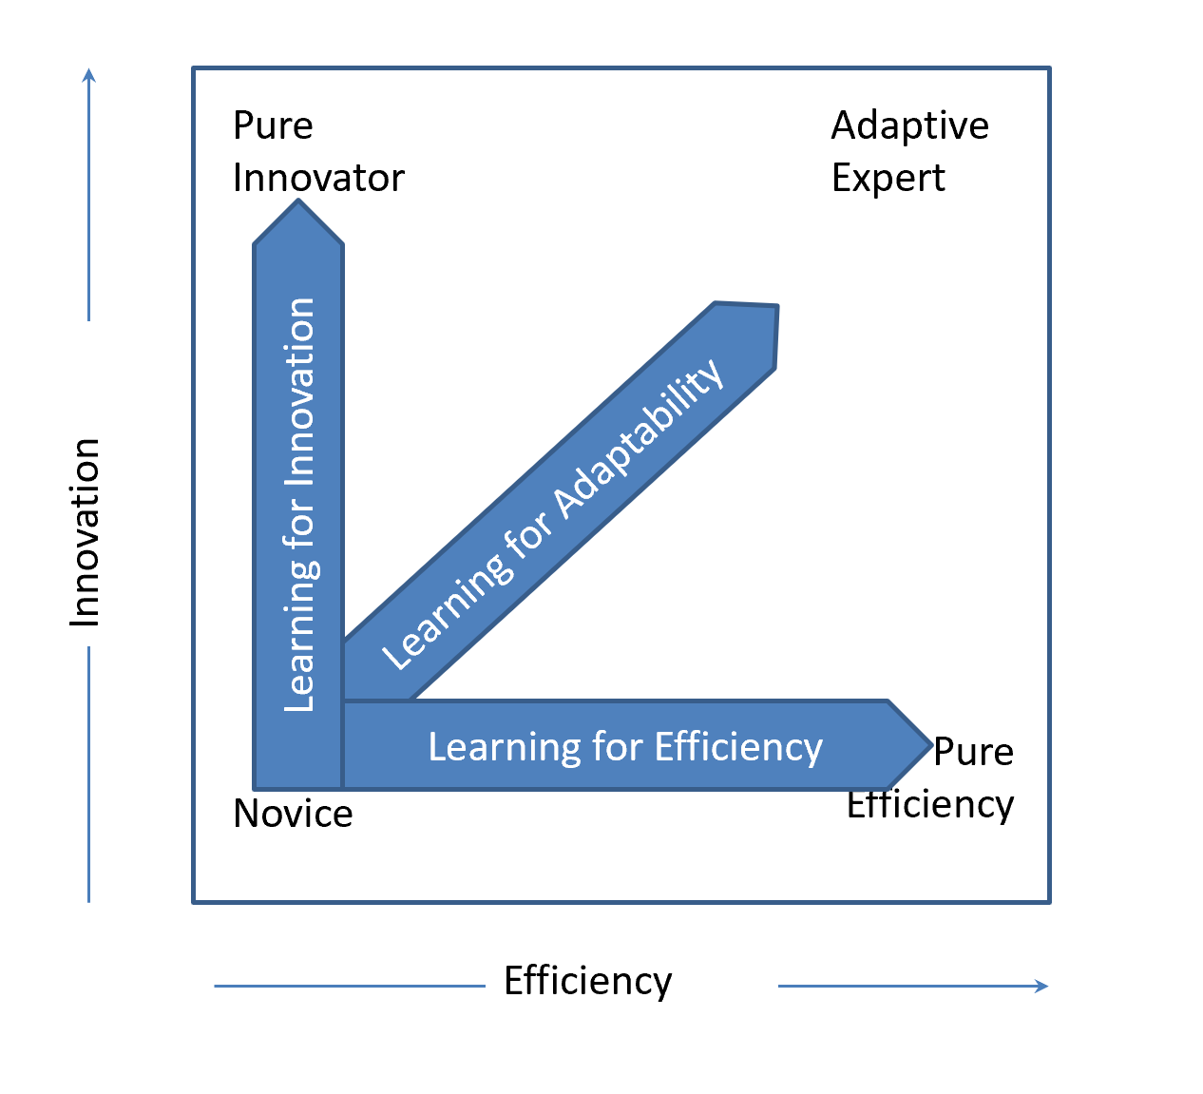
Adjusting

Slide 65
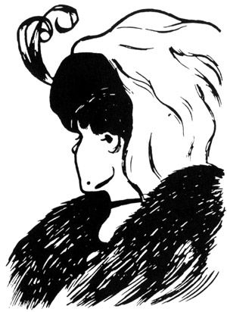

Slide 66
DDX

Slide 67
Pre-Renal Renal Post-Renal

Slide 68
The MAL Model is an advance organizer, or script, for how we want our learners to be in the future.

Slide 69
Learning for Future Learning

