Slide 1
Grace Huang, MD
Associate Professor of Medicine, HMS
Editor-in-Chief, MedEdPORTAL
Scholarship and Recognition: Maximizing the Impact of Your Work
BCH Academy Spring Retreat
April 25, 2018
@GraceH_Rabkin

Slide 2
Objectives
By the end of the session, you will be able to:
APPLY the principles of educational scholarship to your own teaching activities
DESCRIBE the different venues for disseminating and publishing scholarly works in medical education
CONSTRUCT a personal action plan for your own trajectories as educators based on your individual strengths

Slide 3
Instructions
Text 37607 on your phone.
Type 100674 but don’t hit send.

Slide 4
Notes:
Which emoji best represents how you feel about PUBLISHING?
https://www.polleverywhere.com/free_text_polls/OhI9xBmwKJq2rpI

Slide 5
Why is it so hard to publish?

Slide 6
It’s increasingly selective.
Research tools
Research skills
Academic pressure
Manuscript
submissions
are rising
Rigor
Rejections
Desk rejections

Slide 7
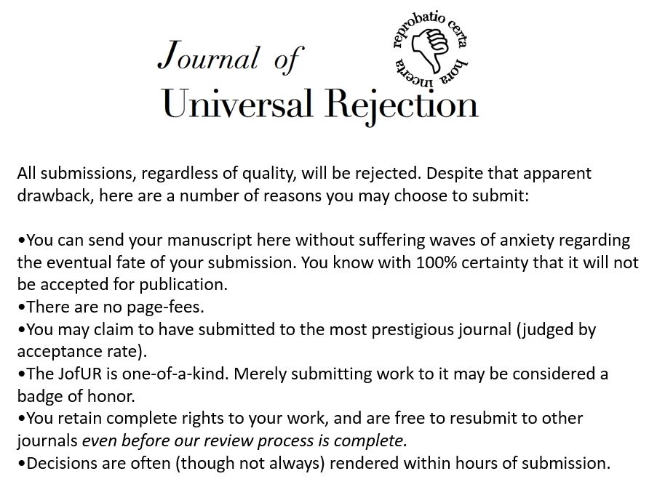

Slide 8
It’s an arbitrary quantification of your worth.
mentoring
planning
evaluating
teaching
curriculum
design
facilitating
H-index?
author
order?
impact
factor?
# pubs?

Slide 9
“Grown-ups like numbers. When you tell them about a new friend, they never ask questions about what really matters.
Only then do they think they know him.”
Le Petit Prince

Slide 10
It’s an institutionalized form of shaming.

Slide 11
effortful
avoid
guilt
procrastinate
shame
the vicious
cycle of the
manuscript
“in draft”

Slide 12
So what is scholarship then?

Slide 13
Scholarship is a trophy.

Slide 14
Scholarship is your gift.
My questions
My answers
My lessons

Slide 15
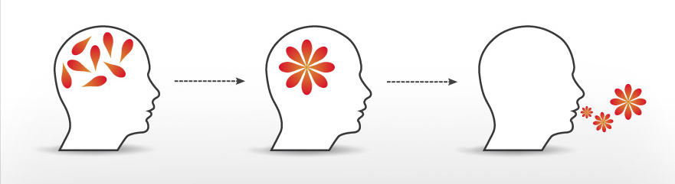
Scholarship is your voice.

Slide 16
What could scholarship look like for you?
Scholarship
Discovery
Integration
Application
Teaching and Learning

Slide 17
Take your teaching to the next level
Good teaching
promotes learning
Scholarly teaching
innovative
Scholarship of teaching and learning
systematic study
purposeful
evidence-based
peer reviewed
Carnegie Foundation
Notes:
First of all, teaching and scholarship of teaching and learning are two dots on the same line.
Like I said, it’s your gift to the world.

Slide 18
Turn teaching into scholarship
a lecture to residents
physical exam videos
a team-based learning exercise
Make it count twice!

Slide 19
Transformation Exercise
THINK: Take a moment to identify your favorite teaching activity.
PAIR: Tell a partner about it.
SHARE: Your partner’s job is to figure out how to turn your teaching into a scholarly activity.

Slide 20
SCHOLARSHIP
DISSEMINATION

Slide 21
Dissemination takes many forms
Dissemination
Talks
Curricula
Clinical guidelines
Multi-inst project
Paper
Posters
Social media
National surveys

Slide 22
Where to publish med ed
QI/Patient Safety
Clinical
BMJ Qual Saf
Am J QUal
Core medical
education
Pediatrics
Acad Ped
JAMA
etc.
Acad Med
Med Educ
JGME
Med Teach
Teach Learn Med
BMC Med Educ
Clinical Teacher
MedEdPORTAL
Educational
research
AHSE
Med Sci Educ
JCHPE
Simulation
Sim Healthc

Slide 23
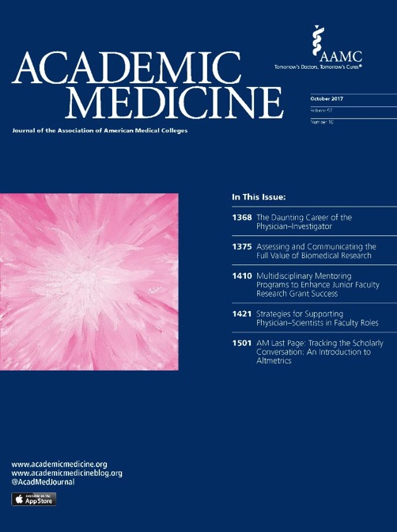
Traditional journals are no longer so traditional

Slide 24
Research Report
Specific research question
Rigorous evaluation methods
Robust data analysis
Findings advance the science of education

Slide 25
Innovation Report
Early stage work
Describes local implementation with obviously generalizable elements
Focus on novelty>>evaluation

Slide 26
Perspectives / Commentaries
Thought-provoking opinion piece
3 T’s
“Title”
“Tone”
“Twist”
Example
“An imperative for the overlooked, outnumbered, and underspoken: why you need to write to lead”

Slide 27
AM Last Page

Slide 28
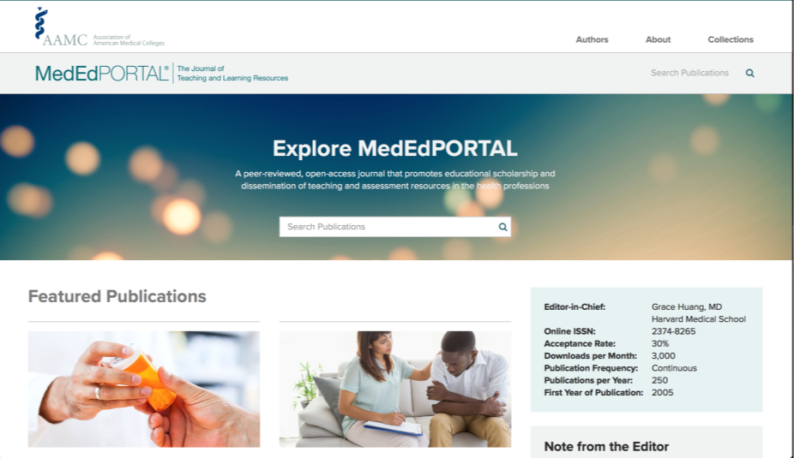
MedEdPORTAL publishes resources
AAMC’s open-access journal (accepted to MEDLINE)
Peer-reviewed medical and dental educational resources that have been implemented and evaluated
Self-contained including materials
www.mededportal.org

Slide 29
Types of MedEdPORTAL publications
Games
Simulation cases
Standardized Patients
Workshops
Virtual Patients
Team-Based Learning
Problem-Based Learning
Interactive Modules
Lectures
Assessment Tools

Slide 30
MedEdPORTAL on the HMS CV
2. Other peer-reviewed scholarship
For example, reviews (such as UpToDate cards), case reports or series, clinical pathologic conference reports, educational materials (e.g. published by MedEdPORTAL) descriptions of new methods or theories or full-length proceedings of meetings which have undergone a formal peer-review process.

Slide 31
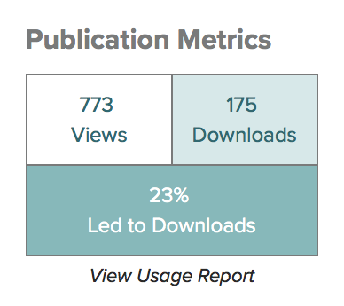

Slide 33
The landscape of publishing
Innovation Reports
Really Good
Stuff (Med Educ)
Original research
Innov (AP)
400
1000-2000
3000
Commentary
(Peds)
Letters to the Editor
12 Tips
(Med Teach)
Groundwork
Validation
Educ Case Reports
(TLM)
New Ideas (JGME)
Patient Narratives
Healing Arts (JGIM), Family Partnerships (Peds), T&L Moments (AM)

Slide 34
How to take the next step

Slide 35
an idea
a talk
a scholarly work
a established reputation

Slide 36
Step 1: Identify your passion
If I could take a one-year sabbatical, I would...
I'm the one everyone in my department calls when...
What gets me up and out of bed Monday morning is...
One thing I love about work that you wouldn't guess is...
I feel a "runners high" at work when I'm...

Slide 37
Translate passion into a niche
THINK: What truly moves you?
PAIR: Tell a partner about it.
SHARE: Your partner’s job is to figure out how to turn your passion into an academic niche.

Slide 38
Step 2: Know your type

Slide 39
Question 1 of 4
I am most comfortable…
in a teaching setting
in front of an audience
working independently

Slide 40
Question 2 of 4
I see new ideas and I immediately…
want to apply them to my teaching
envision the future for my program
want to test them out

Slide 41
Question 3 of 4
I prefer to meet with…
trainees
thought leaders
collaborators

Slide 42
Question 4 of 4
I prefer to be known as…
creative
inspirational
methodical

Slide 43
“Types” of clinician-educators
A
INNOVATOR
B
LEADER
C
RESEARCHER

Slide 44
Innovator Type
Publish these:
Strengths
communication,
creativity
Curricula, program descriptions, innovations
Venues
classroom,
workshops

Slide 45
Leader Type
Publish these:
Strengths
vision,
managing
editorials, commentaries, consensus statements
Venues
plenaries,
panels

Slide 46
Researcher Type
Publish these:
original research, systematic reviews
Strengths
methods,
assessment
Venues
lectures,
oral
presentations

Slide 47
Commitment to Change
IF: questions about yourself
THEN: questions about your affinities
SO: questions about what you plan to do about it

Slide 48
Step 3: Make writing a part of your life.

Slide 49
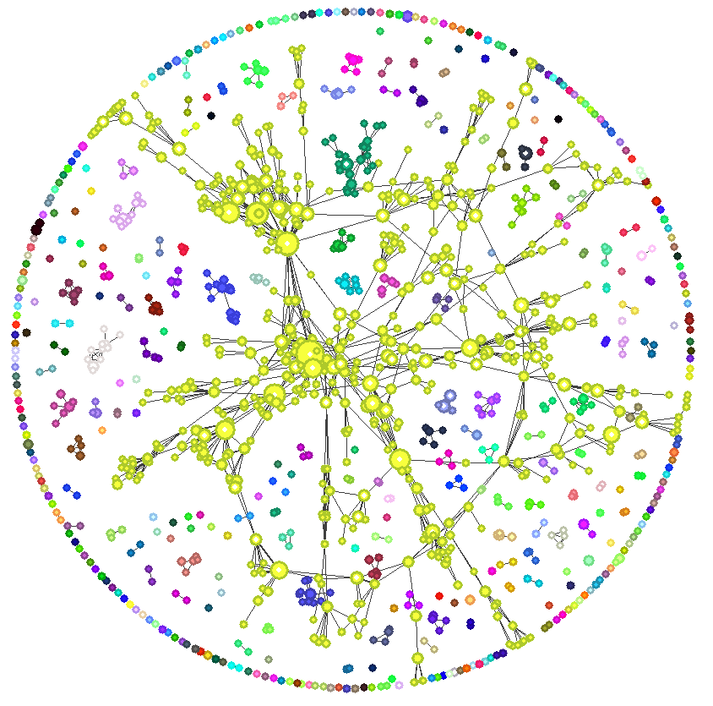
Scholarship is a team sport.
meetings = accountability
co-first authorship = friendly competition
write with writers

Slide 50
The more you write, the more you write.
Get feedback on your writing.
Banish the idea of
not being a writer.

Slide 51
Corollary: The more you read, the more you write

Slide 52
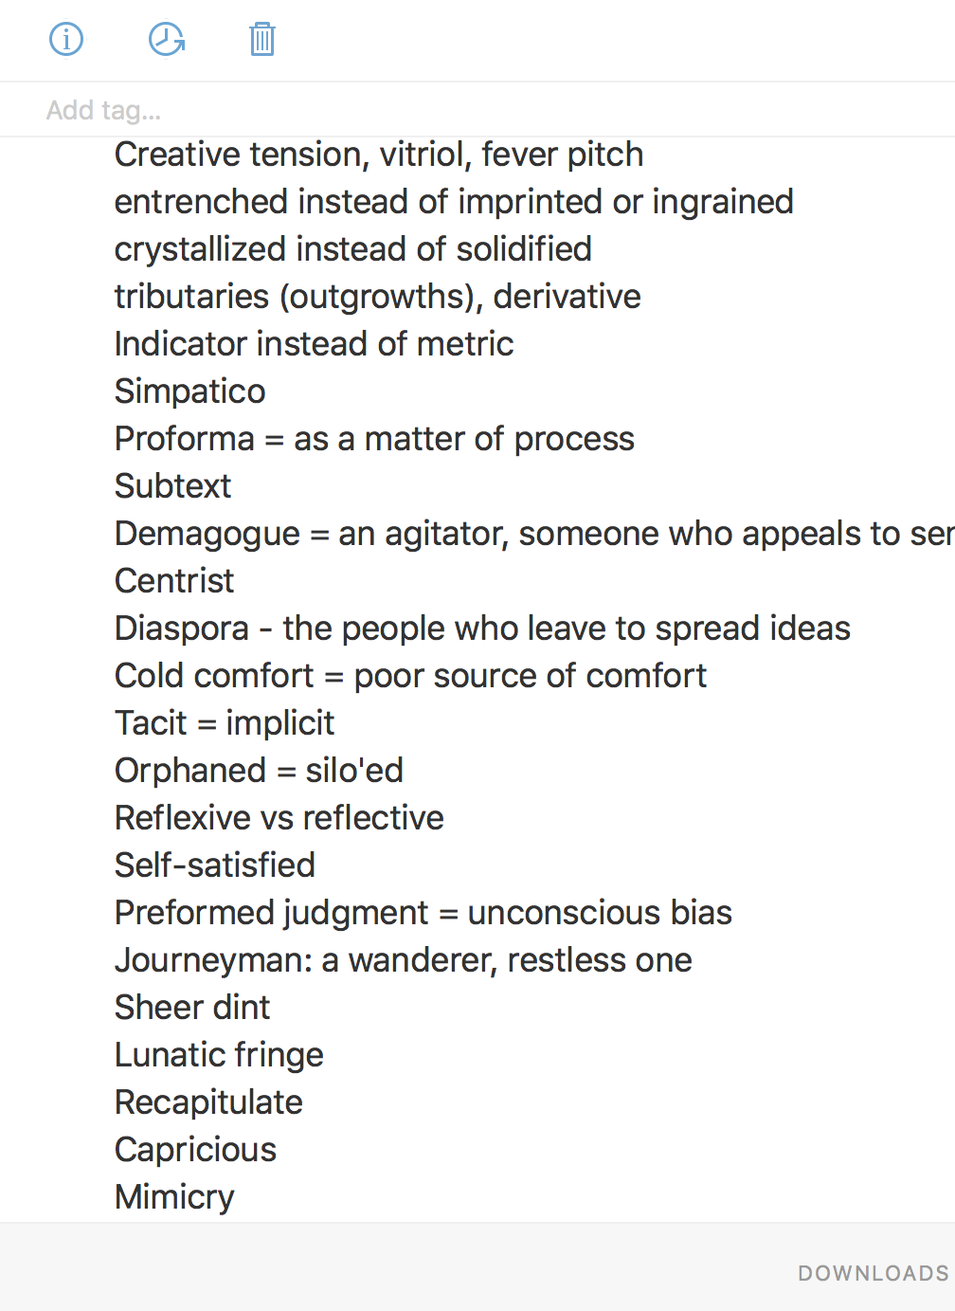
Become a collector of words.

Slide 53
Have an idea repository.

Slide 54
Objectives
Declarations
I WILL
By the end of the session, you will be able to:
APPLY the principles of educational scholarship to your own teaching activities
DESCRIBE the different venues for disseminating and publishing scholarly works in medical education
CONSTRUCT a personal action plan for your own trajectories as educators based on your individual strengths
Make it count twice
Identify my passion
Begin anywhere

