Slide 1
Research and Scholarship in Medical education: overcoming the barriers
Jennifer Kesselheim, MD, EdM
Boston Children’s hospital—spring academy retreat
April 25, 2018

Slide 2
Begin with a story
Inspired by a pediatric oncologist who trained me during fellowship
Expert clinician
Knowledgeable
Facile with the evidence contributing to best practice
Influential investigator
Led numerous clinical trials
Grant funded
Moving the field forward
Inspirational teacher
Dedicated to the training mission
Seized every teachable moment
Provided mentorship

Slide 3
What does pubmed say?
Evidence of his clinical expertise
Numerous clinical practice guidelines, review articles
Documentation of his research success
Myriad clinical trials published
First author, senior author, middle author
Decades of contribution
Teaching?

Slide 4
The problem
The medical literature is filled with reports of clinical innovation and research
We document our experiences, good or bad
Allows the community to learn, progress
In the clinical arena, we demand evidence
When it comes to our teaching, we have been less demanding

Slide 5
Nothing Worth Doing Comes Easily!
Small sample sizes
Research participation fatigue
Many educators lack training in research
Participants learn over time no matter what we do
Time between the learning and the expected outcome may be long
IRB issues

Slide 6
Life of the Investigator
Protected time difficult to secure
Competing demands
Buy-in from supervisors may be a challenge
Research may be undervalued by colleagues
Grants are few
Lack of collaborators
Isolation

Slide 7
Why Do Education Research?
Practice evidence-based education
Similar standards as we expect in clinical practice
Delivers higher quality to our learners
Allows for dissemination of our best work
Speak the language of our colleagues
Measure outcomes of our efforts
Justify resources needed for our programs
Advance our careers

Slide 8
Barrier #1: IRB

Slide 9
Do not omit this step!
Strengthens your project to have their input
Gets things down on paper
Limits publication
Ethical ramifications
Education projects are often deemed exempt from full review
Expedited review or quality improvement

Slide 10
Criteria for Exemption
Research conducted in established educational settings, involving normal educational practices
Eg: research on effectiveness or comparing instructional techniques, curricula
Research involving the use of educational tests, survey procedures, interviews or observation of public behavior UNLESS
Subject could be at greater than minimal risk
Confidentiality cannot be maintained
Research involving the collection or study of existing data, documents, records without subject identification

Slide 11
Tips for working with the IRB
Leave enough time and be efficient!
Email or call with inquiries before submission
Remember administrative review comes first
Collaborators often need to work through their own IRB
Remain open to feedback and refinement of your project
Designation of exemption must be made by IRB (not you)

Slide 12
Tips for Working with the IRB
Balancing risks and benefits for subjects
Risks are usually low but must be explained honestly
Especially if patients or families involved
Largest risk is often confidentiality
Employment and advancement
Privacy considerations
Incentives or compensation
Avoiding undue influence and coercion
Ensure voluntariness

Slide 13
Barrier #2: Small programs

Slide 14
Finding Collaborators
A great strategy to boost your study population size and sample size!
Potential collaborators are likely to be receptive!
Local
HMS Academy
HMS/PME leadership
Hospital-based Academies
GME Community
National
Professional organizations
Personal contacts, mentor contacts

Slide 15
Starting somewhere
A small study is a great first step, especially if data are convincing
Provides pilot data to allow for larger study
Collaborators
Funders
“Really Good Stuff” in Medical Education
500 words, no tables/figures, short report on an innovation
What problem was addressed? What was tried? Lessons learned?

Slide 16
Use methods to your advantage
Some studies do not require a p value to have impact
Qualitative methods
Interviews
Focus groups
Blended or mixed-methods approach
Workshops later this afternoon

Slide 17
Join a Research scholar group!!
Groups of BCH Academy members who present new research ideas and works in progress
Group feedback
Two faculty facilitators and statistician
Compile feedback from the discussion
Great venue for strategizing about challenges of small sample size

Slide 18
Barrier #3: Not enough time!

Slide 19
When time is limited
Leverage work you are already doing to innovate and improve training
Engage in a thorough literature search
Is your intervention truly novel?
Add a component of outcome measurement
What did we accomplish?
Articulate a specific question and investigate its answer
Workshop

Slide 20
Program Evaluation
Results
Behavior
Learning
Reaction
Final results that occurred due to program participation, in vivo
A change in behavior caused by participation in the program
A change in attitudes, knowledge, or skill
How the participants react to the experience, satisfaction
Kirkpatrick DL and Kirkpatrick JD. Evaluating Training Programs: the four levels. 2006.

Slide 21
Example: Reaction

Slide 22
% Agree or Strongly Agree
Question 1: This session touched on issues important in fellowship training
Question 2: This session stimulated reflective communication on this topic
Question 3: This case vignette was useful to the group discussion
Question 4: This session helped us identify useful coping skills for the future
Question 5: Sessions of this type are valuable parts of the overall fellowship curriculum
Question 6: I am looking forward to engaging in more sessions of this type

Slide 23
Example: Learning

Slide 24
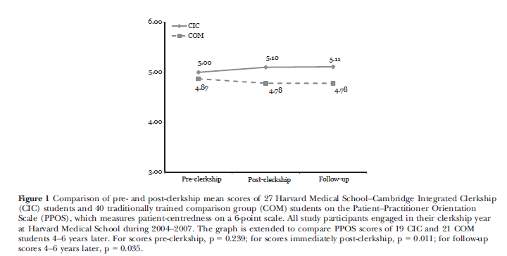
Notes:
This study was intended to measure the impact of a longitudinal integrated clerkship at Harvard medical school. The investigators compared 27 students who went through the integrated with with 40 students who experienced the traditional clerkship model and served as a control group. Their outcome of interest was how students scored on a measure of patient centeredness called the patient-practitioner orientation scale. This would be a measure of attitude change as a result of this innovative program. As you can see here (click to bring in figure), the integrated clerkship students are represented here with the top line and the control group is here underneath. Their patient-centeredness scores are listed here at 3 time points, pre-clerkship, post-clerkship, and follow-up.

Slide 25
Example: Behavior

Slide 26
Notes:
This was a study performed on 3 cohorts of medical students randomly assigned to give oral presentations on rounds without structured feedback from teaching faculty, with simple feedback, or with detailed feedback. At the end of the study the subjects gave oral presentations in front on other preceptors who were blinded to their study group. The preceptors used rating forms to assess the quality of the oral presentations. The investigators found….click to bring in table

Slide 27
Example: Results

Slide 28
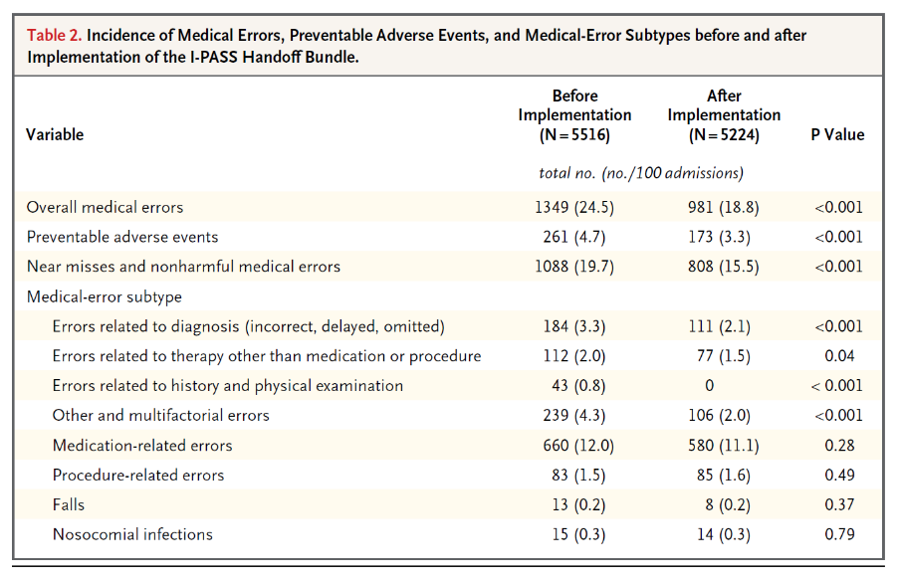
Handoff and Medical Error Rates

Slide 29
Closing Comments
There are a lot of reasons NOT to do medical education research
Numerous barriers
Can be overcome!
The field must move forward for the good of teachers, learners and our patients
Research is critical component of our progress
Good luck!

Slide 30
Contact
Jennifer Kesselheim
jennifer_kesselheim@dfci.harvard.edu
(617) 632-2423

